Slide 1

LIB-AI Roadmap
“Imagine a time when computers could only compute numbers—fast forward to today, they can create art, write essays, and even hold conversations that feel human.
This is the power of AI.”
Empowering Tech & Non-Tech Audiences to Leverage AI

Slide 2
AgENDA
Kavitha
Introduction to AI (General)
Overview of the tracks
Breakdown of 3 tracks:
Non-Tech,
ML, and
Foundation Models
Committee introduction
Session details:
Topics,
Timeline,
Deliverables and
Speakers
Key milestones and expectations

Slide 3
LIB-AI Goals and Vision
Kavitha
Vision:
Inclusive Future in Tech
Transforming the narrative around Women in AI
Mentorship and Networking
Encouraging diversity in thought
Goals of these Sessions:
AI - Empowerment through Knowledge :
Bridge the gender gap in the tech industry and create more opportunities for women in tech roles.
simplify complex concepts like AI,ML, Foundation Models:
This helps women feel more confident in engaging with technical topics, which often seem intimidating at first glance.
Building a Supportive Learning Community:
This community-based learning approach can be incredibly powerful, especially in a space like LeanIn, where there is a strong focus on support, mentorship, and empowerment.

Slide 4
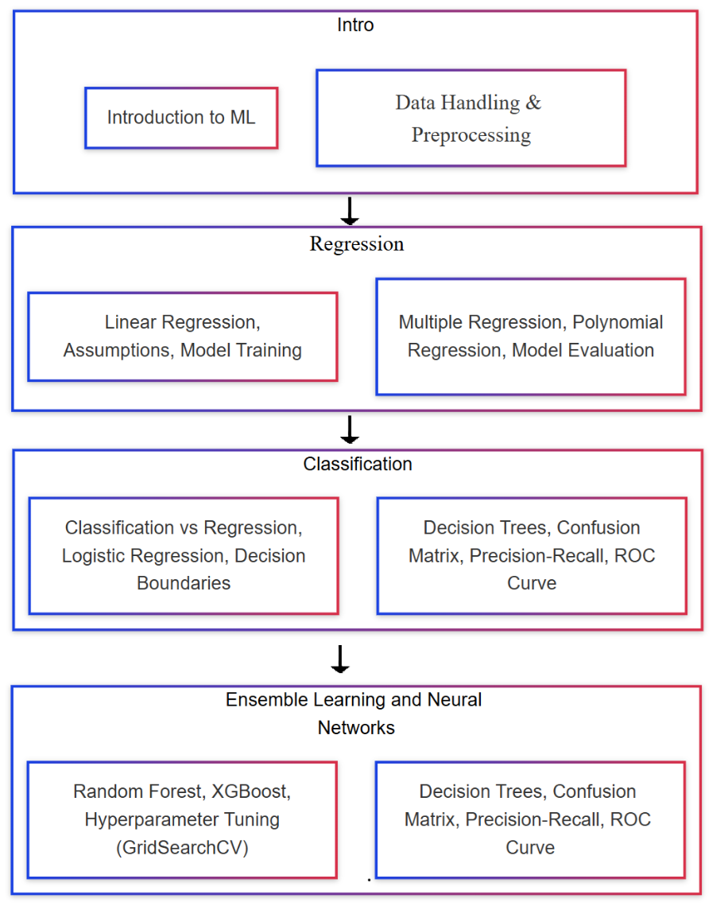
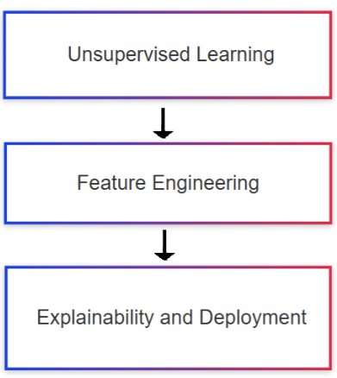
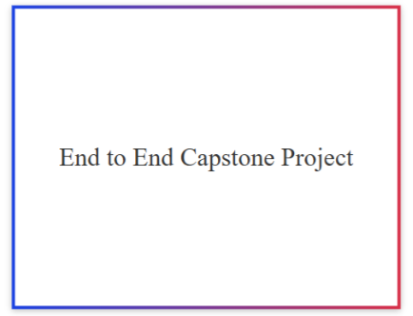
TECH BASIC

Slide 5
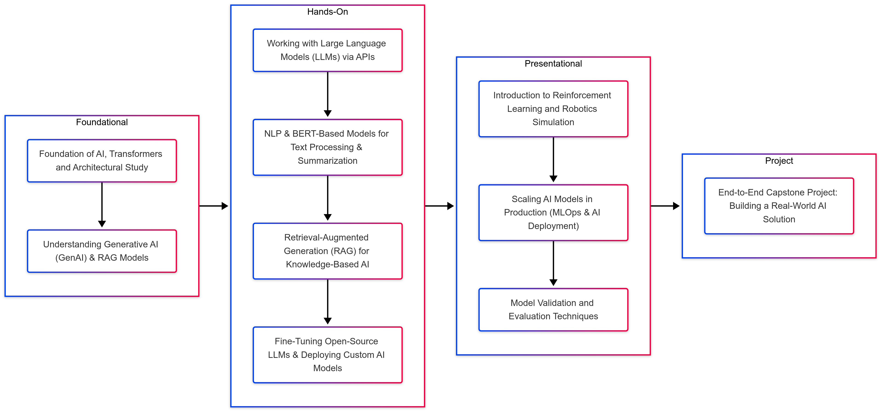
RoadMap – Tech advance

Slide 6
Volunteers chart
Kavitha
Name | Profession | Company | LIB-AI-role | Work experience
Kavitha Yogaraj | Senior Quantum Computational Scientist | IBM Research | Co-founder of LIB-AI & lead for Tech track | 14
Khushi | Lead Data Scientist |  | Co-founder of LIB-AI & lead for Tech track
Sohini |  |  | Co-lead for Tech-track
Manashi Ganguly |  |  | Non-tech Lead
Sweta |  |  | Non-tech Co-Lead

Slide 7
Tech Track Session Speakers
Kavitha
To add details by each individuals
Name | Profession | Company | LIB-AI-role | Work experience
Rajesh
Neha
Jamuna
Vaibhavi
Surya Kumari

Slide 8
Organizing & Market Team
Kavitha
Name | Profession | Company | LIB-AI-role | Work experience
Preethi |  |  |  | Lead Co-Ordinator
Ranjini Rao |  |  |  | Lead Digital Marketing
Tejaswini |  |  |  | Digital Marketing
Devansh |  |  |  | Digital Marketing

Slide 9
Introduction to Tracks
Kavitha
Track | Frequency | Total Sessions | Time
Non-Tech Track | Quarterly once | 4 | 1-2 hrs
Tech – ML Track | Every First Saturday of the month | 12 | 2 hrs
Tech – Foundation Models | Every First Saturday of the month | 12 | 2 hrs
Non-Tech Track: Business professionals, product managers, marketers, entrepreneurs, and AI enthusiasts with no or minimal technical background.
Tech – ML Track: Data scientists, software developers, data analysts, and engineers who want to learn about machine learning and its practical applications.
Tech – Foundation Models: AI researchers, advanced data scientists, NLP engineers, and AI/ML engineers with a focus on large-scale language models and deep learning technologies.

Slide 10
Responsibilities of the lead and co-lead for each track.
Overall Project Management:
Ensure that all sessions and topics are aligned with the larger goal of the 12-month project.
Set and communicate deadlines for content preparation, speaker readiness, and any follow-up tasks.
Track the progress of the roadmap, ensuring that the sessions are scheduled, the speakers are prepared, and the content is delivered on time.
Monitor and track participant progress across the sessions
Content & Curriculum Verification:
Ensure the content is comprehensive and consistent across all sessions, integrating real-world applications, mathematical explanations, and practical demonstrations.
Oversee that each speaker follows the structured format (Concept - Application - Mathematical - Notebook) for their respective sessions.
Help speakers by providing guidance on how to break down complex AI concepts into layman’s terms, ensuring clarity for the audience
Speaker Support & Coordination
Act as the main point of contact for each session’s speaker to offer assistance where needed (e.g., PPT creation, demo preparation).
Ensure that all session content is peer-reviewed or checked for consistency before delivery.
Help align the individual speakers with the broader project goals.

Slide 11
Structure of each session
Kavitha
Introduce Concept – PPT – In Layman Terms
Application – Where Can It Be Used?
Mathematical – Explanation
Notebook – Go Through the Notebook with Results

Slide 12
Track Outcomes
Kavitha
Non-Tech Track Learning Outcomes
Business understanding, AI applications, ethical considerations.
ML Track Learning Outcomes
Model building, data handling, model evaluation techniques.
Foundation Model Track Learning Outcomes
Fine-tuning and applying pre-trained models to NLP tasks.
Overall Learning Outcomes
How all tracks contribute to a holistic AI understanding.

Slide 13
Non-Tech Track
Kavitha
Audience:
Business Professionals: Managers, Executives, Product Managers, and anyone in a business role who needs to understand the strategic and practical aspects of AI and its applications without needing deep technical expertise.
Entrepreneurs: Those looking to integrate AI into their business models, products, or services but without deep technical knowledge.
Sales & Marketing Professionals: Individuals in sales, business development, or marketing who need to understand AI to communicate its value to clients or stakeholders.
AI Enthusiasts: People interested in AI but without a technical background who want to understand the fundamentals of how AI is applied in the business world.
Focus Areas:
AI applications in business, marketing, customer service, finance, and operations.
Understanding AI concepts at a high level: what AI can do, its impact on industries, and its ethical considerations.
No deep technical knowledge required.

Slide 14
Tech – ML Track
Kavitha
Audience:
Data Scientists: Professionals with a background in data analysis and statistics looking to dive deeper into machine learning algorithms and techniques.
Software Developers: Developers interested in transitioning to data science and machine learning roles, or those wanting to integrate ML into their existing applications.
Data Analysts: Individuals with strong data-handling skills who want to move into predictive modeling and machine learning.
Engineers: Technical professionals looking to understand and implement machine learning algorithms in real-world problems.
Focus Areas:
Building machine learning models: regression, classification, clustering, ensemble methods, etc.
Techniques for data preprocessing, handling data, and working with machine learning pipelines.
Hands-on with ML tools like Python and Scikit-learn.
Key ML concepts like model evaluation, cross-validation, and hyperparameter tuning.

Slide 15
Tech – Foundation Models (LLMs and NLP)
Kavitha
Audience:
Advanced Data Scientists: Data scientists who have a solid understanding of machine learning and are looking to specialize in deep learning, particularly large language models (LLMs) and other foundational models.
NLP Engineers: Professionals specifically working in Natural Language Processing, text generation, and conversational AI who want to deepen their expertise in LLMs.
AI/ML Engineers: Engineers looking to design, deploy, or optimize large-scale AI systems based on foundation models.
Focus Areas:
Understanding foundation models (e.g., GPT, BERT, T5) and their architectures.
Fine-tuning pre-trained models for NLP tasks: sentiment analysis, summarization, translation, etc.
Deep learning, transformers, attention mechanisms, and state-of-the-art NLP techniques.
Scaling LLMs and deploying them in real-world applications, focusing on the nuances of model performance, resource consumption, and operational challenges.

Slide 16
Non-tech Track
Kavitha
Manashi & Sweta to edit this
4 sessions and topics, panel discussion, invite guest speakers talk, etc..
Session | AI Concepts | Use Cases & Business Impact | Challenges & Ethical Considerations | Speaker Name
1 | Introduction to AI & ML | AI in everyday life (Netflix, Google, ChatGPT) | Myths vs Reality of AI
2 | How AI Learns (Supervised vs Unsupervised) | AI in Healthcare, Finance, Retail | Data Bias & AI Fairness
3 | Machine Learning vs Deep Learning vs GenAI | How AI helps in decision-making | AI and Privacy (GDPR, data security) | taken
4 | Explainable AI (XAI) | Case Studies: AI in Fraud Detection, Marketing | Risks of AI in Business (Hallucinations, Bias)
5 | AI Implementation in Business | AI Adoption Strategies | Human-AI Collaboration & Future of Work
6 | Future Trends in AI | Emerging AI applications (Quantum AI, AGI) | Open Discussion & AI Strategy Planning | taken

Slide 17
Sessions | Main | Topics covered | Speaker name
1 | Introduction to ML | What is ML? Types of ML, ML pipeline, Applications | Kavitha
2 | Data Handling & Preprocessing | Data types, Pandas, Data Cleaning, Feature Scaling, Encoding , power BI | Vaibhavi
3 | Model Training | Model Training | Rajesh
4 | Regression | Linear Regression, Assumptions, Model Evaluation (RMSE, R²) | Vaibhavi
5 | Classification | Classification vs Regression, Logistic Regression, Decision Boundaries
6 | Classification | Decision Trees, Confusion Matrix, Precision-Recall, ROC Curve | Neha
7 | Ensemble & Tuning | Ensemble Learning (Random Forest, XGBoost), Hyperparameter Tuning (GridSearchCV) | Neha
8 | Unsupervised Learning | Clustering (K-Means, Hierarchical), PCA | Jamuna
9 | Feature Engineering | Feature Selection, Feature Engineering, Bias-Variance Tradeoff | Jamuna
10 | Deployment | ML operations pipeline & Model Deployment | Rajesh
11-12 | Capstone Project | End-to-End Capstone Project | Kavitha
Kavitha

Slide 18
Tools and Technologies
Kavitha
Tools for Data Handling and Preprocessing
Python, Pandas, Numpy, Power BI.
Tools for Machine Learning
TensorFlow, Keras, Scikit-learn.
Tools for NLP and LLMs
HuggingFace, SpaCy, GPT, BERT.
Cloud Tools for Deployment
AWS, Azure, Google Cloud.

Slide 19
Success Stories and Case Studies
Kavitha
ML Success Stories
Use cases where machine learning models have made a significant impact.
Impact of Capstone Projects
Showcase 10 sessions by building end to end project and deploy

Slide 20
Overview
Designed to bridge the gap between AI concepts and practical implementations.
We will be working with
Large Language Models (LLMs)
Retrieval-Augmented Generation (RAG)
NLP models,
Reinforcement learning
AI deployment strategies.

Slide 21
Who Should Join
AI enthusiasts, developers, and professionals looking to deepen their practical AI skills.
Anyone with basic Python programming knowledge
Experience with NumPy, Pandas, or ML libraries is helpful but not mandatory
General understanding of AI concepts find the sessions easier to follow.

Slide 22
What to Expect?
Hands-on coding
Real-world applications
Guided learning: Step-by-step implementations
Capstone Projects

Slide 23
EXPECTED TECH STACKs
Python IDEs
Google-Colab, Kaggle Notebooks , Paperspace etc.
AI Studios and Platforms
Google Vertex AI & AI Studio
Hugging Face Inference API
AWS Bedrock
Lightning AI
Vector Stores
FAISS
ChromaDB
Weaviate
GPU , TPU based environment

Slide 24
Speakers
Rajesh – Toast Inc – 6+ yrs exp : Senior Software Engineer
Backend engineering and MLOps.
Passionate about Long running , Cycling , Swimming.
https://www.linkedin.com/in/rajesh-somasundaram-13254335/s
Surya Kumari 20+ yrs exp, Genai COE
Expert @ Gen AI and LLMs.
Hobbies include reading autobiographies and playing chess.
https://www.linkedin.com/in/suryakumarisaripalli-04668717/
Neha Mittal, Algorithm Developer, Applied Materials
Worked on several internal hackathons on LLMs and Diffusion Models.
Love tinkering Arduino, playing badminton.

Slide 25
Sessions | Main | Topics covered | Speaker name
1 | Foundation of AI, Transformers and Architectural Study | Understanding the core underlying architectures | Khushi
2 | Understanding Generative AI (GenAI) & RAG Models | Basics of GenAI, LLMs, embeddings, RAG principles. | Surya Kumari
3 | Working with Large Language Models (LLMs) via APIs | Calling LLM APIs, fine-tuning prompts, optimizing queries. | Khushi
4 | NLP & BERT-Based Models for Text Processing & Summarization | Text classification, named entity recognition (NER), summarization, Q&A. | Khushi
5 | Retrieval-Augmented Generation (RAG) for Knowledge-Based AI | Setting up vector stores, embedding retrieval, advanced RAG workflows. | Neha Mittal and Khushi
6 | Fine-Tuning Open-Source LLMs & Deploying Custom AI Models | Customizing AI models for domain-specific applications. | Neha Mittal and Khushi
7 | Introduction to Reinforcement Learning and Robotics Simulation | Using Open AI’s Gym and other simulation Libraries | Khushi
8 | Scaling AI Models in Production (MLOps & AI Deployment) | Automating model deployment, retraining, and real-time monitoring. | Rajesh
9 | Model Validation and Evaluation Techniques |  | --
10 | End-to-End Capstone Project: Building a Real-World AI Solution | Developing a fully functional AI system using learned techniques. | Khushi
11

Slide 26
Conclusion
By the end of this training, participants will:
Gain hands-on experience in building, fine-tuning, and deploying AI models.
Learn to work with LLMs, vector databases, and RAG workflows.
Be able to train custom AI models and optimize prompts for various applications.
Apply their skills in a real-world AI capstone project.

Slide 27
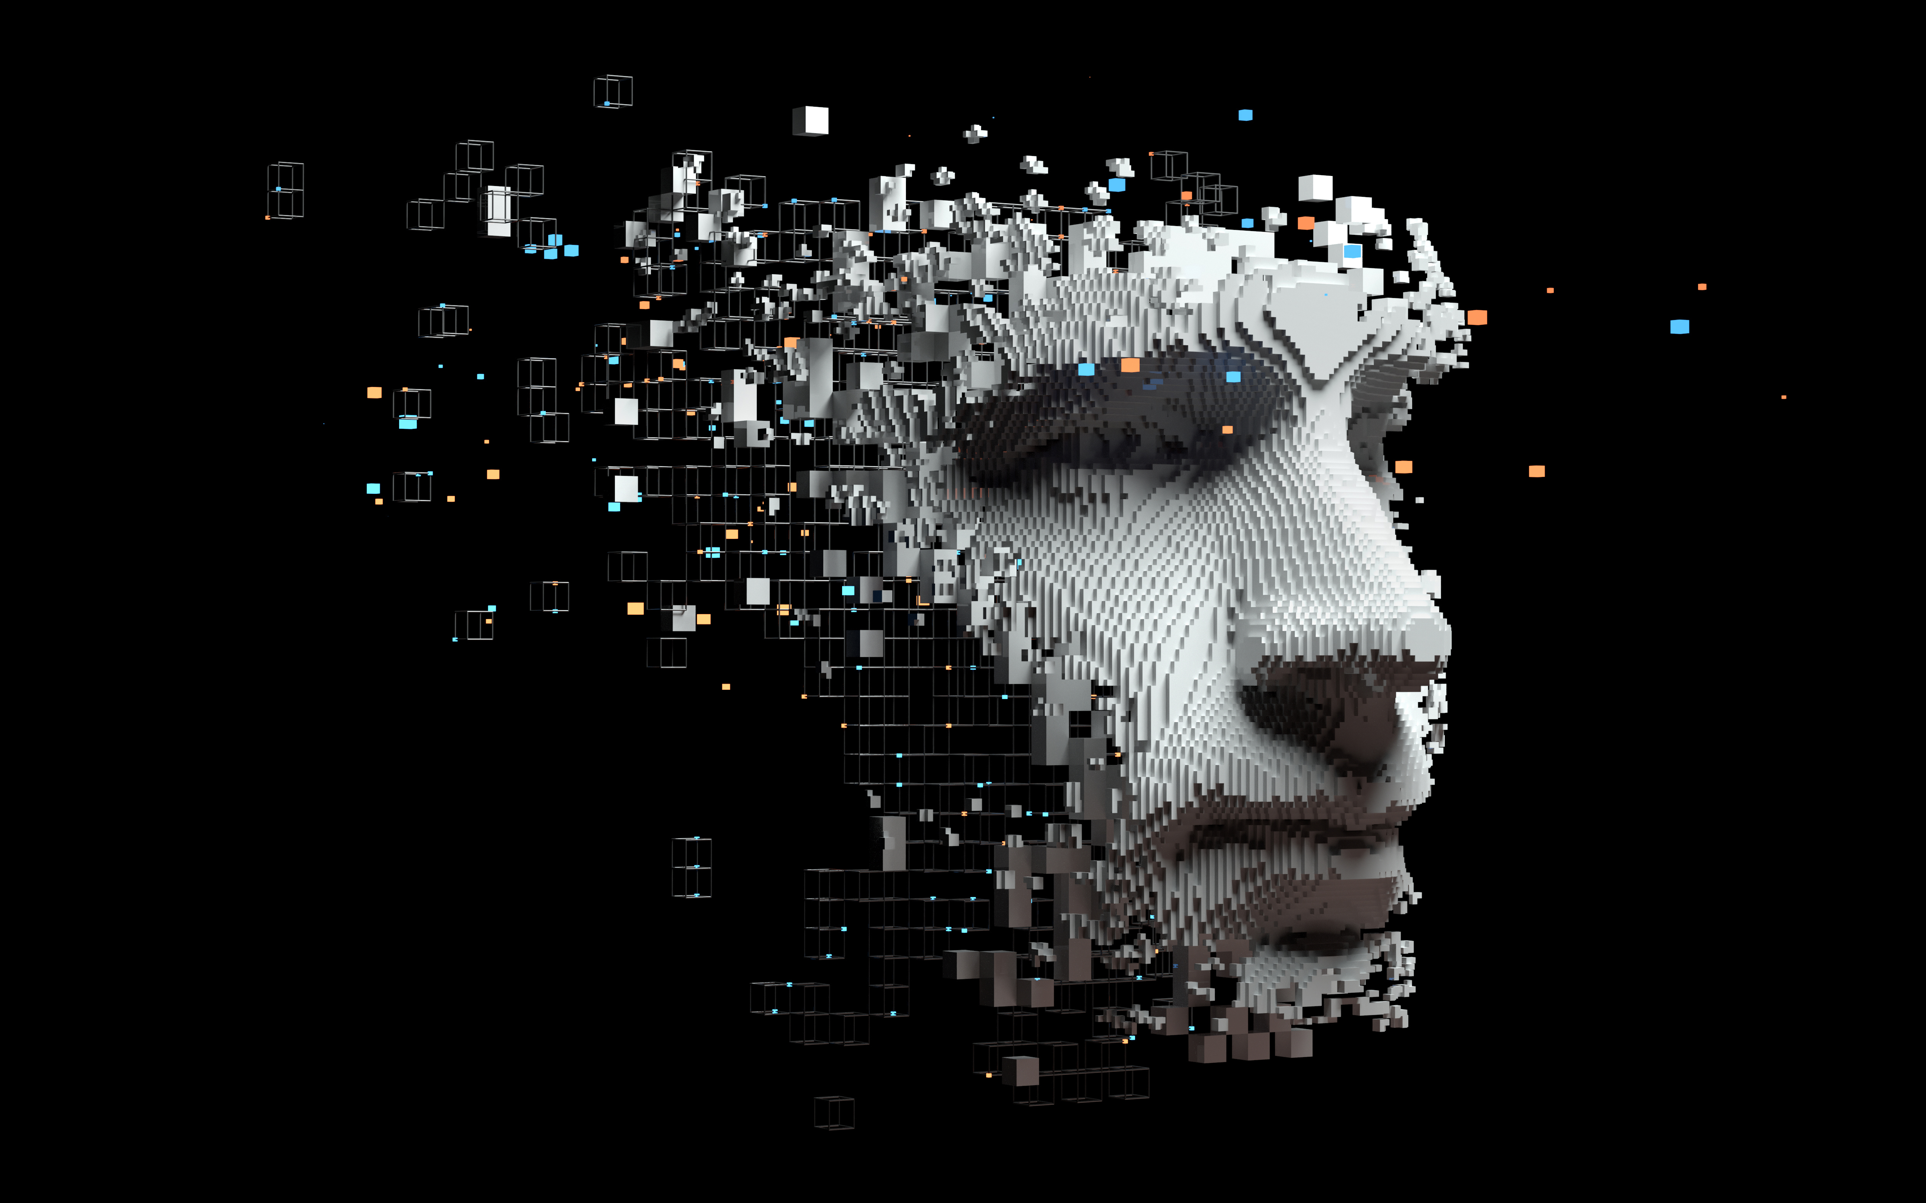
Introduction to AI
Manashi
Evolution of AI: Historical timeline and milestones.
AI Before and After LLMs
Why AI Is for Everyone
General ML/DL vs AI
AI Trends Across Industries
Platforms for Non-Tech Users
Getting Started as a Non-Tech Professional
Data Analytics and Visualization
Data Engineering for AI
The Future of AI
AI touches every profession, industry, and even personal productivity. Whether you’re a teacher customizing lesson plans or a marketer using AI to analyze trends, there’s something for everyone.

Slide 28
Evolution of AI: Historical timeline and milestones.
Manashi
2020s: Generative AI (GenAI), Retrieval-Augmented Generation (RAG), and Agentic AI.
Today - Hybrid AI: AI combined with sensors and IoT creating ubiquitous autonomous systems. For example, autonomous vehicles using AI alongside LiDAR and GPS sensors.
1950s-80s: Early AI systems – Rule-based systems and symbolic reasoning.
1990s-2000s: Machine Learning (ML) emergence – Algorithms trained on structured data.
2010s: Deep Learning (DL) and Neural Networks revolutionizing industries.
STEP 3
FUTURE STATE
STEP 2
CURRENT STATE
STEP 1
Notes:
In 1997, IBM’s Deep Blue beat the world chess champion Garry Kasparov. At the time, it was seen as a monumental AI breakthrough. Today, we can play better chess with apps on our phones. Tesla's autopilot doesn’t just use AI—it integrates sensors, cameras, and IoT to navigate roads.AI adoption has grown 270% in businesses over the past four years (source: Gartner).

Slide 29
AI Before and After LLMs
Manashi
AI After LLMs:
AI Before LLMs:
Enhanced human-like understanding (e.g., ChatGPT).
Shift towards Agentic AI: Systems capable of autonomous decision-making (e.g., autonomous drones, robotic advisors).
Context-aware systems processing unstructured data, conversational AI (e.g., ChatGPT, Bard).
Focused on pattern recognition, structured data, and supervised learning.
Limited conversational abilities and creativity.
Rule-based AI handling structured data, used for specific tasks like fraud detection.
Notes:
Pre-LLMs was like a calculator; post-LLMs is like having a full-fledged assistant who understands and anticipates your needs.”
Ex - A retailer using LLMs to personalize customer shopping experiences, resulting in a 20% sales increase.

Slide 30
Why AI Is for Everyone – AI isn’t about replacing jobs—it’s about making our lives and work smarter
Manashi
Have you Noticed ?
AI is democratized: No longer limited to tech companies.
Everyday tools for non-tech users (e.g., Grammarly, Canva).
Empowers industries from education to logistics.
AI Seeping into Non-Tech Fields:
AI applications in content creation, marketing, logistics, and even agriculture.
Everyday tools like chatbots, recommendation engines, and virtual assistants empower non-tech professionals.
Why Everyone Can Benefit:
AI democratizes opportunities. For example:
Small businesses scaling using AI-driven insights.
Creative professionals enhancing output with tools like Canva and RunwayML.
Notes:
A small bakery owner in India used AI to predict demand and doubled her sales during holidays.
37% of companies use AI, but 63% of non-tech professionals don’t know where to start (McKinsey).

Slide 31
General ML/DL vs AI
Manashi
ML : Algorithms learning from data.
AI : The umbrella term that includes ML/DL and extends to reasoning, problem-solving, and creative tasks.
DL : Subset of ML using neural networks for complex tasks.
ML/DL: Models trained to perform specific tasks (e.g., Netflix recommendations).
AI: Broader intelligence, reasoning, and adaptation across domains (e.g., autonomous vehicles).
Notes:
In healthcare, ML predicts diseases from X-rays, while AI designs customized treatment plans for patients. Think of ML/DL as building blocks—AI is the architect who uses those blocks creatively.

Slide 32
AI Trends Across Industries
Manashi
Banking & Finance:
Healthcare:
E-commerce:
EdTech:
Adaptive learning platforms, virtual tutors, content curation for learners.
Recommendation engines, personalized marketing, AI-driven inventory management.
Predictive diagnostics, drug discovery, virtual health assistants.
Fraud detection, personalized financial planning using AI chatbots.
Banking: Fraud detection, credit risk modeling.
Healthcare: AI-based diagnostics, personalized medicine.
E-commerce: Chatbots, supply chain optimization.
EdTech: Virtual tutors, adaptive learning paths.
Notes:
Finance: AI identifies suspicious transactions within milliseconds.
EdTech: AI platforms create tailored learning experiences for students.

Slide 33
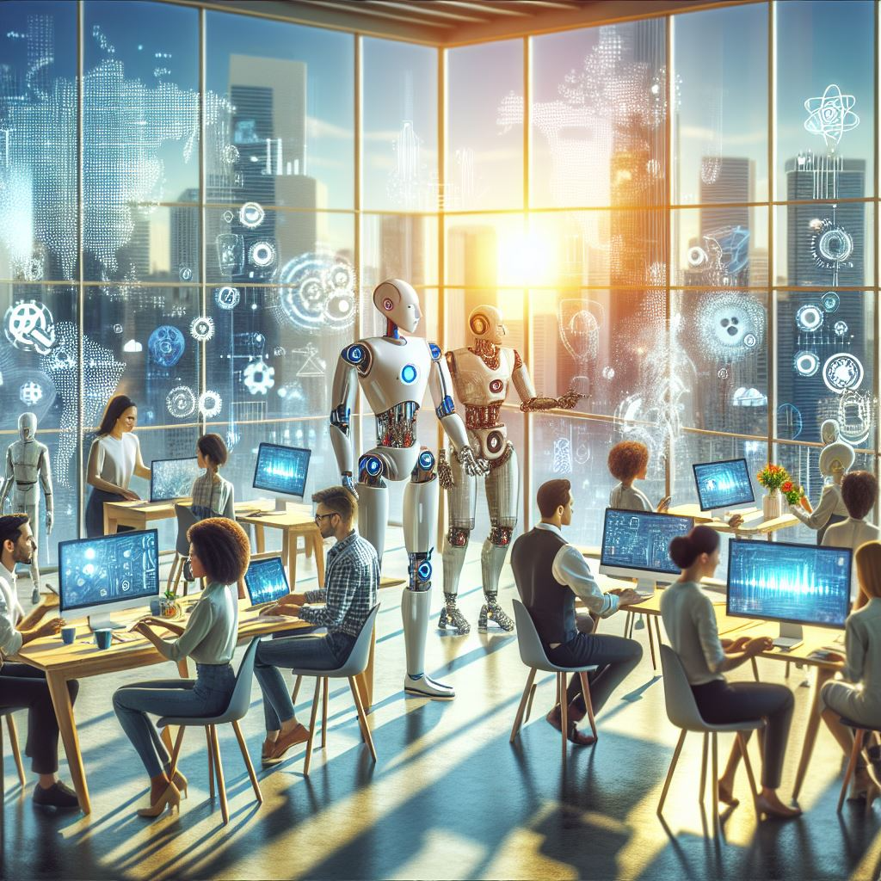
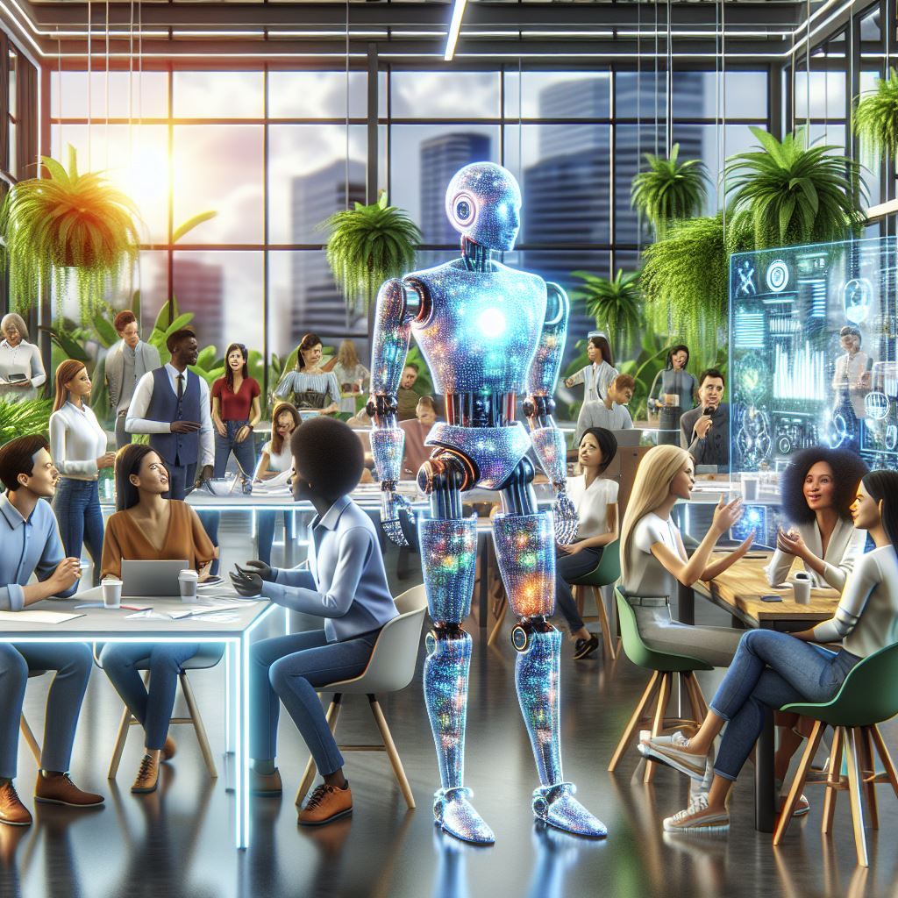
Closing Thought
Manashi
AI is the bridge between imagination and reality. Your role is to walk across that bridge and bring back value for your business, industry, or even personal growth
AI is no longer confined to coders and tech wizards. It’s a tool for everyone, from entrepreneurs to educators. The future belongs to those who can harness its power to create innovative solutions and transform industries.
Notes:
You don’t need to be an AI expert to use AI—start small, experiment, and watch how it transforms your world.

Slide 34
The Future of AI
Manashi
Key Points:
AI + IoT will power autonomous systems (e.g., self-driving cars, smart cities).
Ethics, sustainability, and personalization will shape AI’s growth.
Notes:
By 2030, AI will add $15.7 trillion to the global economy (PwC).
Visionary Insight: “Imagine farms where AI manages irrigation based on weather data—saving water and increasing yield. This isn’t science fiction; it’s happening now.”

